Slide 1
DOS Attack Case Study
By Bhavya

Slide 2
ABSTRACT
The current project entails an extensive examination of various forms of DoS attacks such as ICMP flooding, TCP SYN flooding, and HTTP flooding within a virtual environment employing Kali Linux and Ubuntu Server.
The goal of this study is to learn how DoS attacks affect the target system, what their effects are, and how they can be detected by analyzing different DoS attacks on network, transport, and application layers.
For the purpose of this study, the attacks will be simulated using hping3 and Slow Loris, among others.
The system and network behaviors will be monitored via tcpdump and other utilities.
Moreover, defensive methods such as iptables firewall configuration, rate limiting, SYN cookies, and connection control were employed to counter the attacks. The results showed a marked decrease in malicious packets, higher CPU efficiency, and greater server stability after security controls were applied.

Slide 3
PROBLEM STATEMENT
Currently, modern web applications and network services are more susceptible to DoS attacks due to the intention of the attackers to hinder access to the service by flooding the targeted resources with excessive traffic.
Volumetric DoS attacks such as ICMP flood, protocol-based DoS attacks like TCP SYN flood, and application-level DoS attacks such as HTTP floods have varied properties that affect the target computer in unique ways.
While many DoS attacks occur regularly and significantly, the detection and prevention of these attacks continue to present a significant challenge in determining whether they are actual attacks and not just legitimate traffic.
Most businesses do not know how to react to DoS attacks and understand their effects on the system.
Hence, there is a need for the simulation of multiple DoS attacks to analyze the various aspects of each attack vector.

Slide 4
THE SOLUTION
In order to analyze and implement the countermeasures against Denial of Service (DoS) attacks, the solution was created through the use of an experimental environment which uses Kali Linux as the attacking computer and Ubuntu Server as the target.
There are several attacks that can be launched by using Kali Linux in an attempt to disrupt the functionality of Ubuntu Server.
These attacks include ICMP flooding (volume-based), TCP SYN flooding (protocol-based), and HTTP flooding using the Slowloris attack (application layer).
These attacks were performed through the use of proper software like hping3 and Slowloris.
The performance of the systems as well as their network activities were also constantly monitored through tcpdump and monitoring software.
Some of the most important signatures include heavy ICMP packet generation, incomplete TCP handshakes, and numerous HTTP connections.

Slide 5
TOOLS AND TECHNOLOGIES USED
Virtualization Platform: VMware Workstation
Operating Systems: Kali Linux was chosen as an attacker OS because of its ability to conduct penetration testing, and Ubuntu Server was employed as the target OS that hosted the web server.
Attacks: hping3 tool was used for conducting ICMP and TCP SYN flood attacks, and Slow Loris was used for creating HTTP flood attacks in the application layer.
Analysis Tools: tcpdump was employed for capturing and analyzing traffic, and top/htop and ss tools were used for observing CPU usage and open connections.
Web Server: Apache2 was installed on Ubuntu Server and used as a web service target.
Countermeasures: Firewalling with iptables, rate limiting, SYN cookies, and connection limiting were considered in order to protect against DoS attacks.

Slide 6
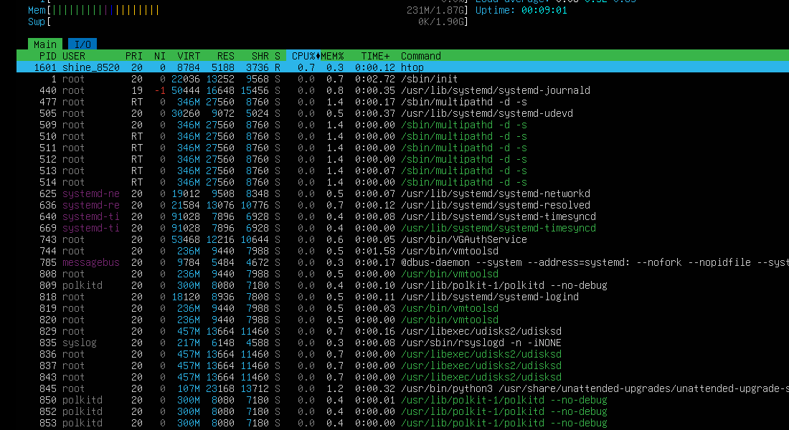
PROJECT IMPLEMENTATION

Slide 7
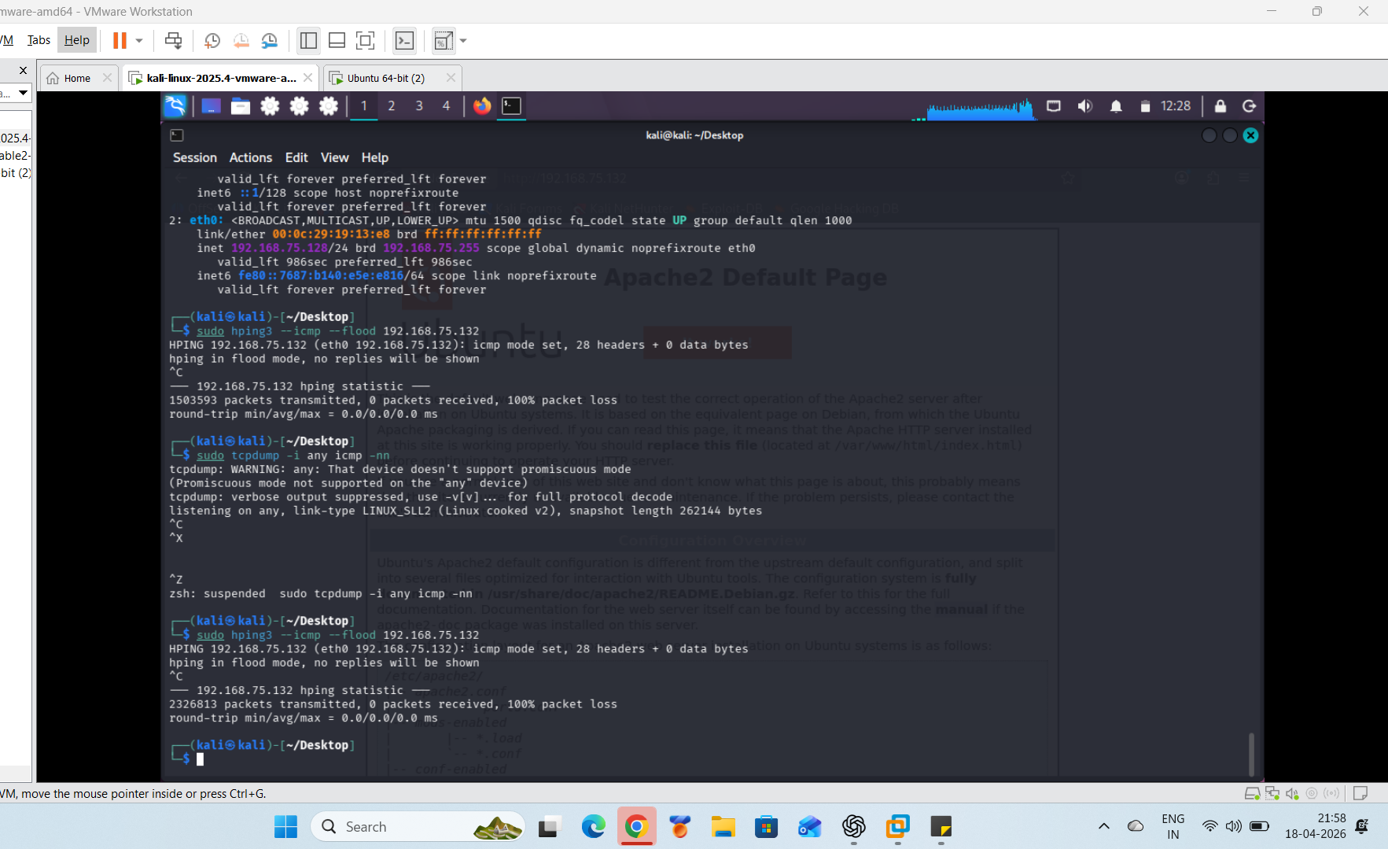

Slide 8
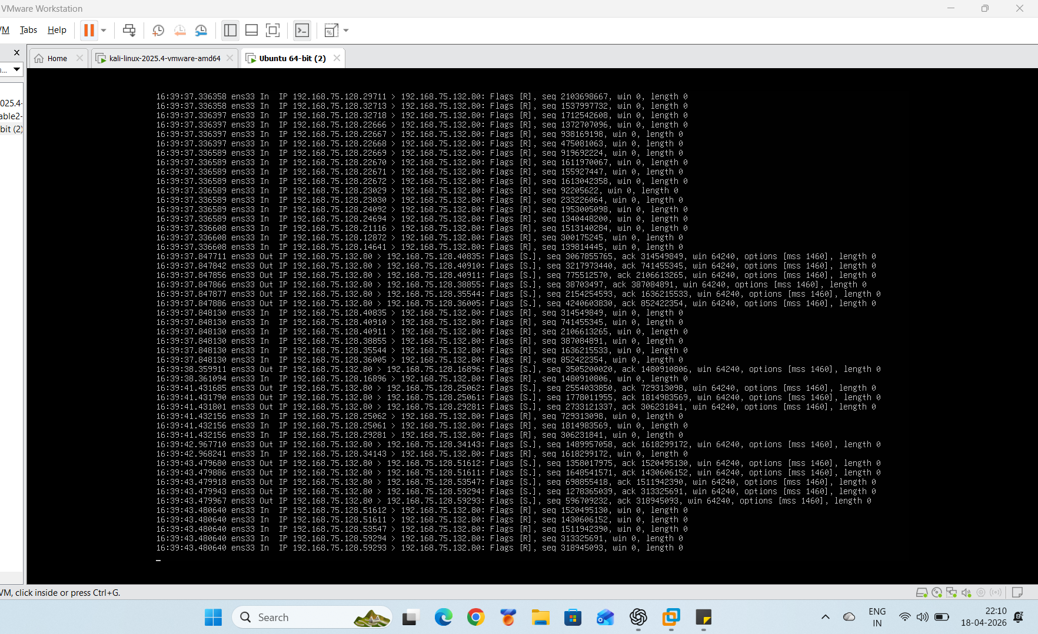

Slide 9
CONCLUSION
This assignment proved to be highly successful in demonstrating how various forms of DoS attacks can be simulated, analyzed, and mitigated within the safe confines of a laboratory setting.
The ability to execute ICMP flood attack, TCP SYN flood attack, and HTTP flood attack allowed us to understand how different forms of attacks affect the availability of bandwidth, number of connections, and resources on application layer.
Traffic analysis performed with the help of tcpdump and other system monitoring utilities helped us in recognizing important aspects of attack including high packet rates, incomplete TCP handshake, and excessive number of concurrent connections.

